Slide 1
DISTRICT ATTENDANCE PROGRAM
Student Services Department​
ATTENDANCE DATA REPORTING
Ascellia M. Arenas,
District Coordinator, Attendance

Slide 2
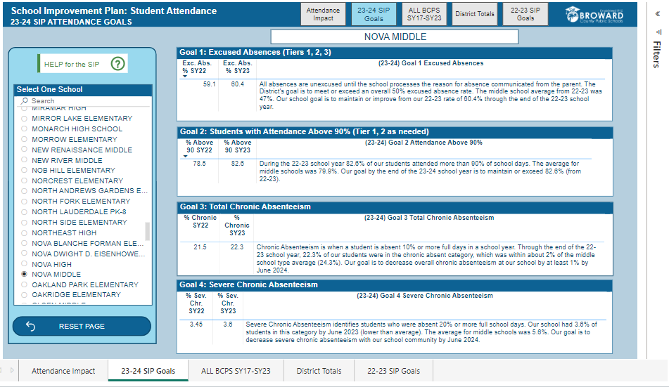
Attendance Plan: Steps to Completion and Approval
Use the Mandatory Attendance Canvas Course Dashboard--Each school's goals are pre-written for staff to copy & paste into the Attendance Plan. The Attendance Office analyzes all school data to provide SMART goals. An administrator will work with the staff member responsible for the Attendance Plan. This Dashboard can be found in the Mandatory Attendance Course for Administrators or Teachers in section 4.4 SIP Attendance Dashboard.
Copy & paste the populated data from the SIP Attendance Dashboard to the 2024/2025 Attendance Plan Worksheet
Attendance Goals
Goal 1: Excused Absence Rate | Copy & paste the goal here (from the dashboard in the Mandatory Attendance Training 24-25, available July 1, 2024). Change font color to black.
Goal 2: Students with Attendance Above 90% | Copy & paste goal here (from the dashboard in the Mandatory Attendance Training 24-25). Change font color to black.
Goal 3: Total Chronic Absenteeism | Copy & paste the goal here (from the dashboard in the Mandatory Attendance Training 24-25). Change font color to black.
Goal 4: Severe Chronic Absenteeism | Copy & paste the goal here (from the dashboard in the Mandatory Attendance Training 24-25). Change font color to black.
absences
2-3 absences
ATTENDANCE PLAN: Ascellia Arenas 754-321-1623

Slide 3
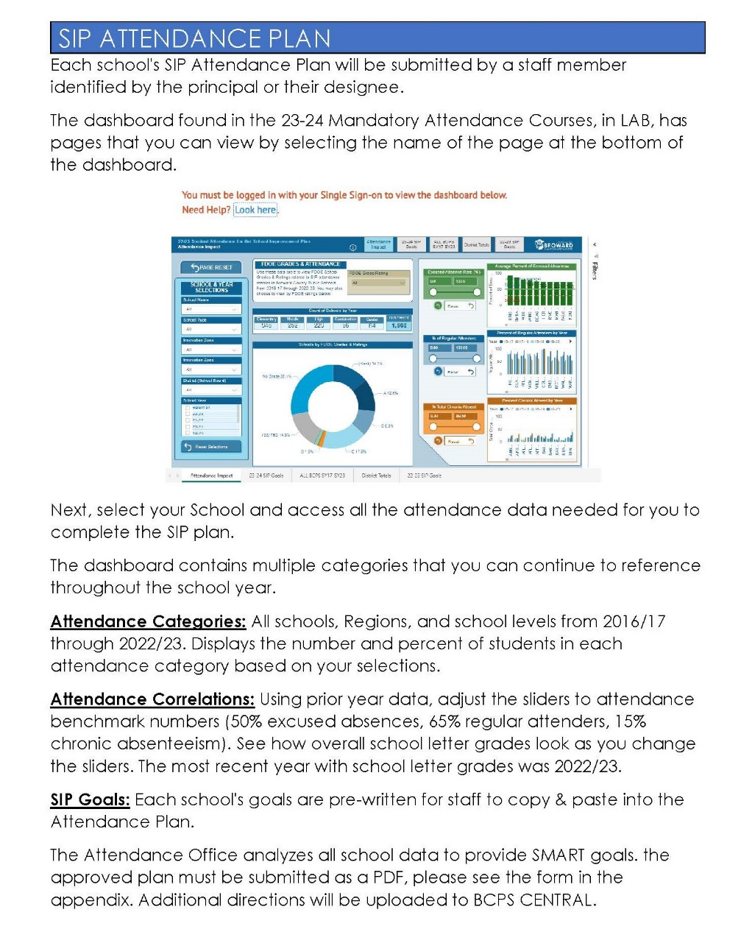
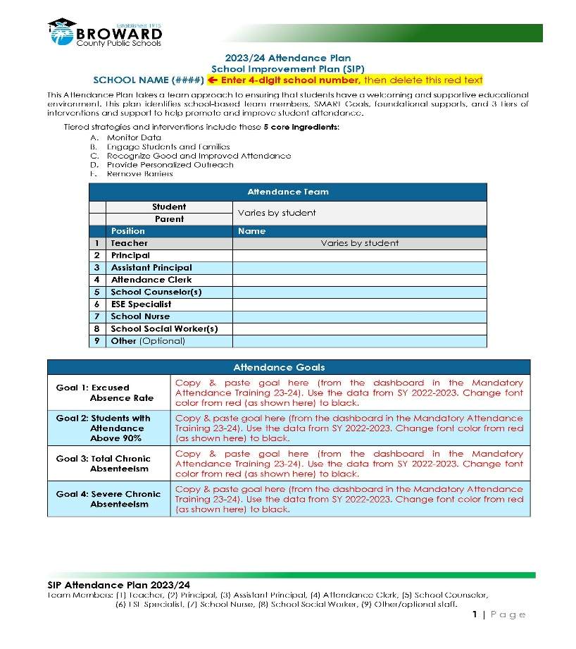
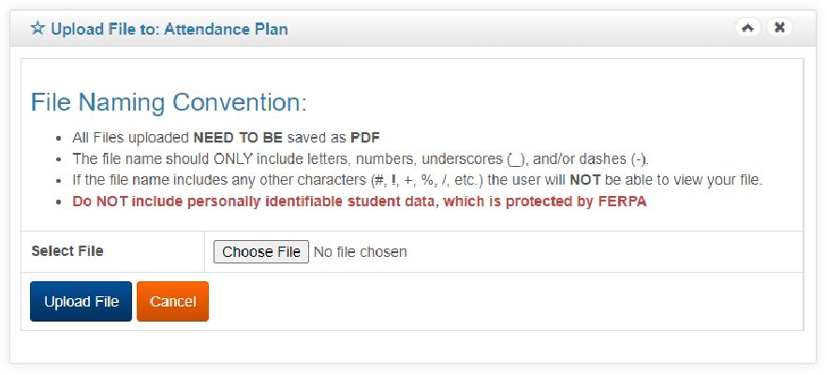
Attendance Plan: Steps to Completion and Approval
Directions:
ATTENDANCE PLAN: Ascellia Arenas 754-321-1623

Slide 4
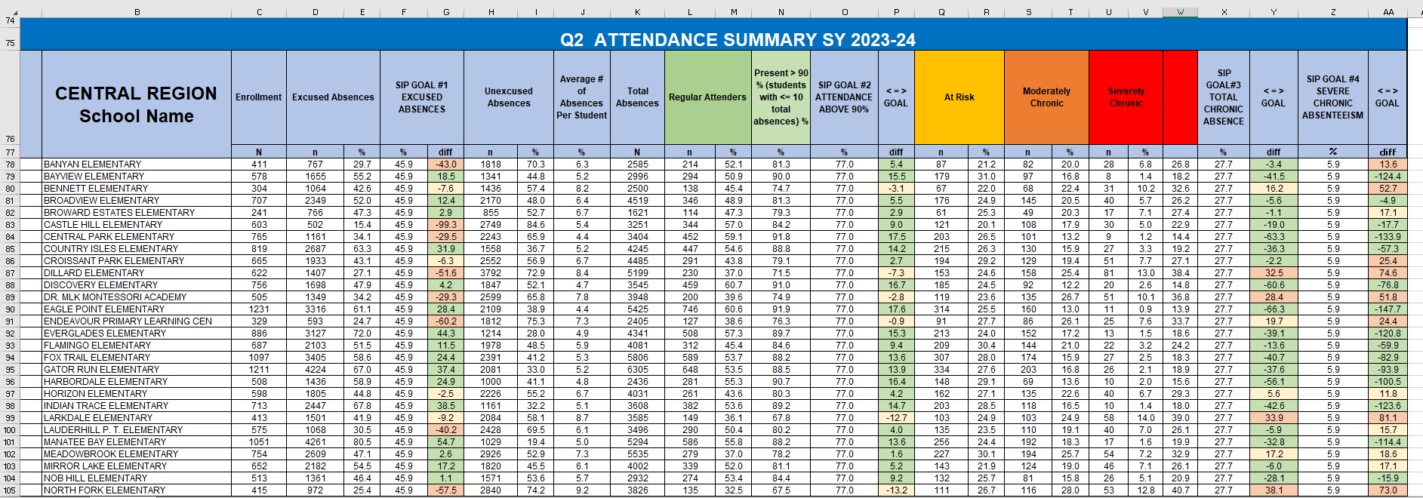
QUARTERLY ATTENDANCE REPORTS
Attendance report included a SIP Goal update.
Notes:
There have been several occurrences where misinformation has been shared regarding district policy and procedures on attendance and withdrawal of students. Some schools divulged that they withdraw students after 10 consecutive days of absence, there has been mention of an extended absence form.
According to State Statute and District Policy the following information is what we are to adhere to.
Nonattendance for instructional activities is established by tardiness, early-sign-outs, or absences for all or any part of the day. The District recommends that students attend school every day.
A pattern of nonattendance shall be reviewed by the Collaborative Problem-Solving Team to assist in identifying strategies and/or interventions intended to improve academic performance and student engagement. A pattern of nonattendance may be identified based on one or more of the following:
Prior history of chronic absenteeism (to provide interventions at the beginning of the school year)
Chronic absenteeism within the current school year
Habitual Truancy
Excessive absences due to illness (excused and/or unexcused). This may be 3 or more consecutive days or more than 8 nonconsecutive days in a school year
Unless acceptable documentation is presented/submitted, an accumulation of daily unexcused absences by tardiness, or early sign-outs that equals 5 days (30 hours) in a marking period or 10 days (60 hours) within two marking periods may establish a pattern of nonattendance.
If the student exhibits a pattern of nonattendance, principals may request documentation for subsequent absences (F.S. s. 1003.24(4)). Nonattendance for instructional activities is established by tardiness, early sign-outs, or absences for all or any part of the day.
"Habitual truant" means a student who has 15 unexcused absences within 90 calendar days with or without the knowledge or consent of the student’s parent, is subject to compulsory school attendance under F.S. ss. 1003.21(1) and (2)(a) and is not exempt under F.S. s.1003.21(3) or s.1003.24, or by meeting the criteria for any other exemption specified by law or rules of the State Board of Education. Such a student must have been the subject of the activities specified in ss. 1003.26 and 1003.27(3), without resultant successful remediation of the truancy problem before being dealt with as a child in need of services according to the provisions of chapter 984 (F.S. s. 1003.01(8)).
Hom, 1003.01(13)(d) and 1003.21.e Education Program: For Home Education attendance requirements see Board Policy 6000.1 and F.S. ss. 1002.41

Slide 6
Thank You ☺
Call me: 754-321-1623 or 954-260-3954
Email me: ascellia.arenas@browardschools.com

Slide 7
Insert title page 11

